Slide 1

BoardOS Project
Master's Degree in Computer Engineering
Cybersecurity
Presented by:
Jacopo Coniglio
Francesca Coriale
Sibilla Merlo
Giulia Lydia Perini
Ankesh Porwal
A.Y. 2023/2024

Slide 2

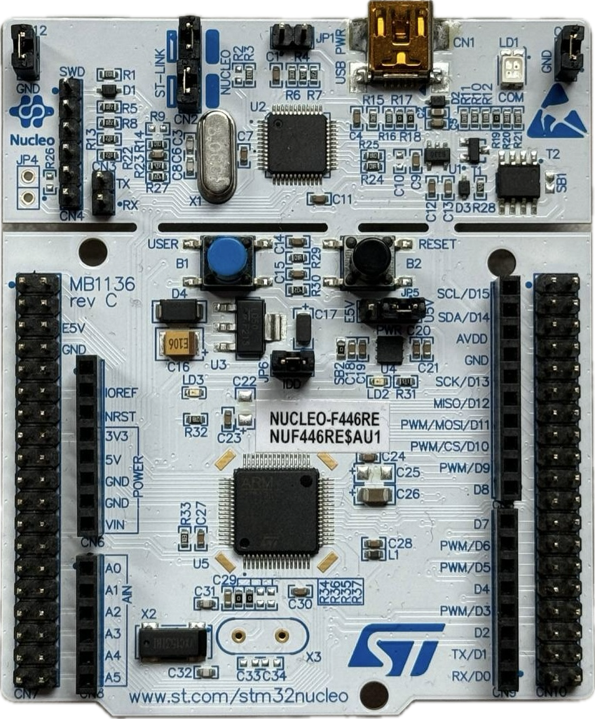
The project required the usage of a STM32 Nucleo-64 Board paired with STM32F446RE microcontroller. We used FreeRTOS for the implementation of exercises.

Slide 3

Index
Point 1: Installation and usage procedures
Point 2: Examples illustrating the functionalities of the board
Point 3: Customization of the operating system
Point 4: Benchmarks of the results obtained in point 3

Slide 4
Index
Point 1: Installation and usage procedures
Point 1: Installation and usage procedures
Point 2: Examples illustrating the functionalities of the board
Point 3: Customization of the operating system
Point 4: Benchmarks of the results obtained in point 3

Slide 5



Point 1: Installation and usage procedures
Requirements
Device running Windows OS (7, 8, or 10), Linux 64-bit, or macOS
USB Type-A to Mini-B cable to connect the board to the device

Slide 6
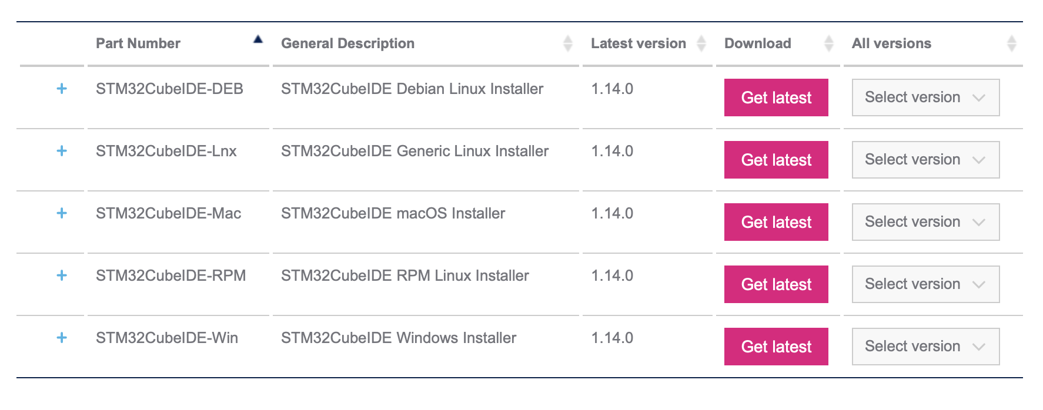
Point 1: Installation and usage procedures
Initial steps
Users must register on the official ST website at www.st.com
Download STM32CubeIDE-xxx
Connect the board to the device
Launch the application

Slide 7
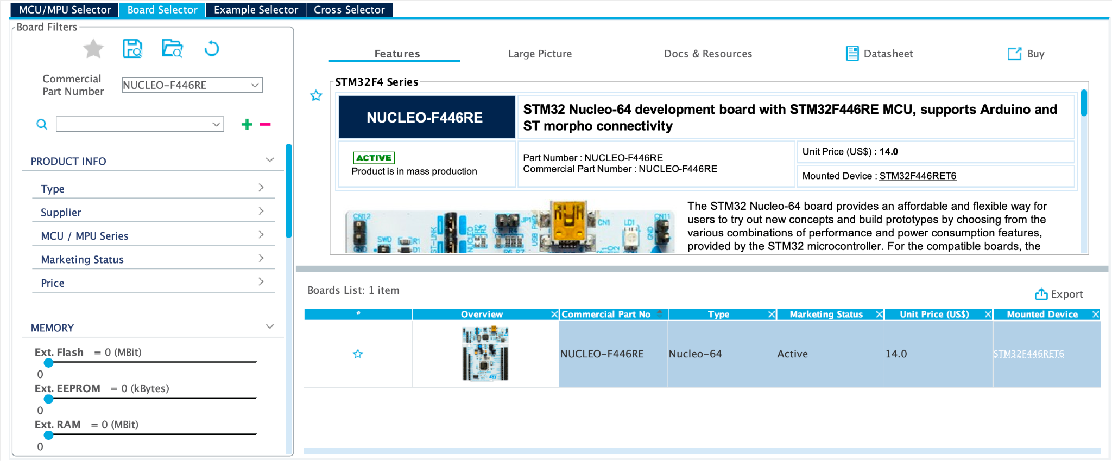
Point 1: Installation and usage procedures
Creating a project
Define a workspace
Select the specific MCU or MPU or choose the board

Slide 8
Index
Point 2: Examples illustrating the functionalities of the board
Point 1: Installation and usage procedures
Point 2: Examples illustrating the functionalities of the board
Point 3: Customization of the operating system
Point 4: Benchmarks of the results obtained in point 3

Slide 9
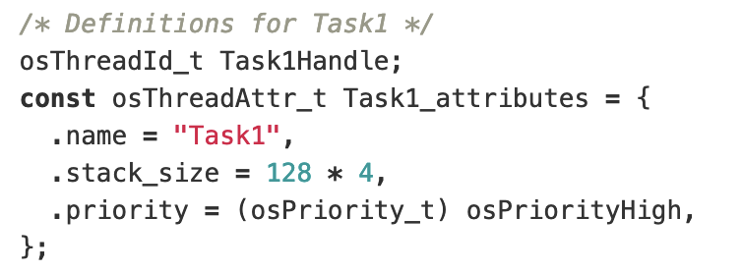
Point 2: Examples
Example 0: Basic Scheduling
Aim: explanation of how scheduling works in FreeRTOS
Three tasks: High, Medium and Low priority
After oSKernelStart() operation the scheduler starts

Slide 10
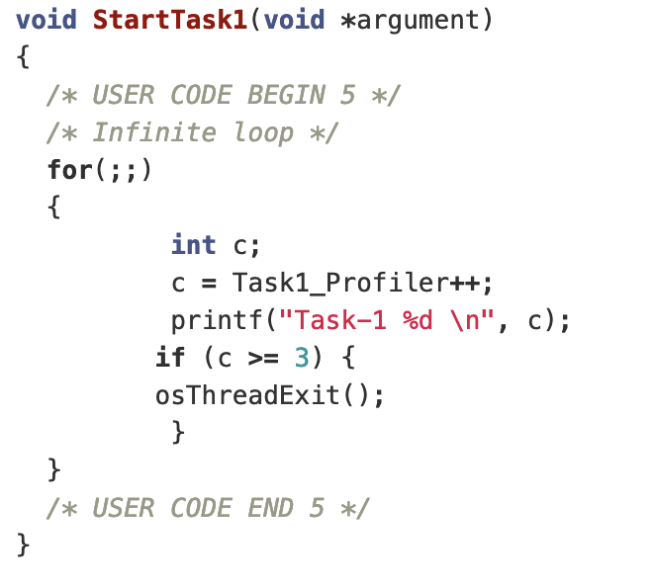
Point 2: Examples
Example 0: Basic Scheduling
Each task has an infinite loop that makes it to execute 3 times
Then terminate
First task chosen is High task, then Medium and then Low

Slide 11
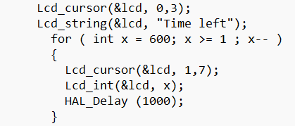
Point 2: Examples
Example 1: LCD1602
Aim: initialization and use of an LCD1602 screen to display a message “Time left” and a countdown from 600 to 1
Writes the string "Time left" to the LCD1602 display at position (0,3)
The HAL_Delay function creates a time interval between iterations of the for loop, thus producing a visual countdown effect on the display

Slide 12
Point 2: Examples
Example 1: LCD1602
ports: an array of GPIO port configurations. This array specifies the GPIO ports used for communication with the LCD: GPIOC, GPIOB, GPIOA are being passed.
pins: an array of GPIO pin configurations. This array specifies the specific pins within the GPIO ports used for communication with the LCD: GPIO_PIN_7, GPIO_PIN_6 are being passed.
lcd_4_bit_mode: indicates that the LCD is configured to use a 4-bit data bus mode, a common configuration for interfacing with LCDs.
gpio_pin_4: this is used for the EN function.

Slide 13
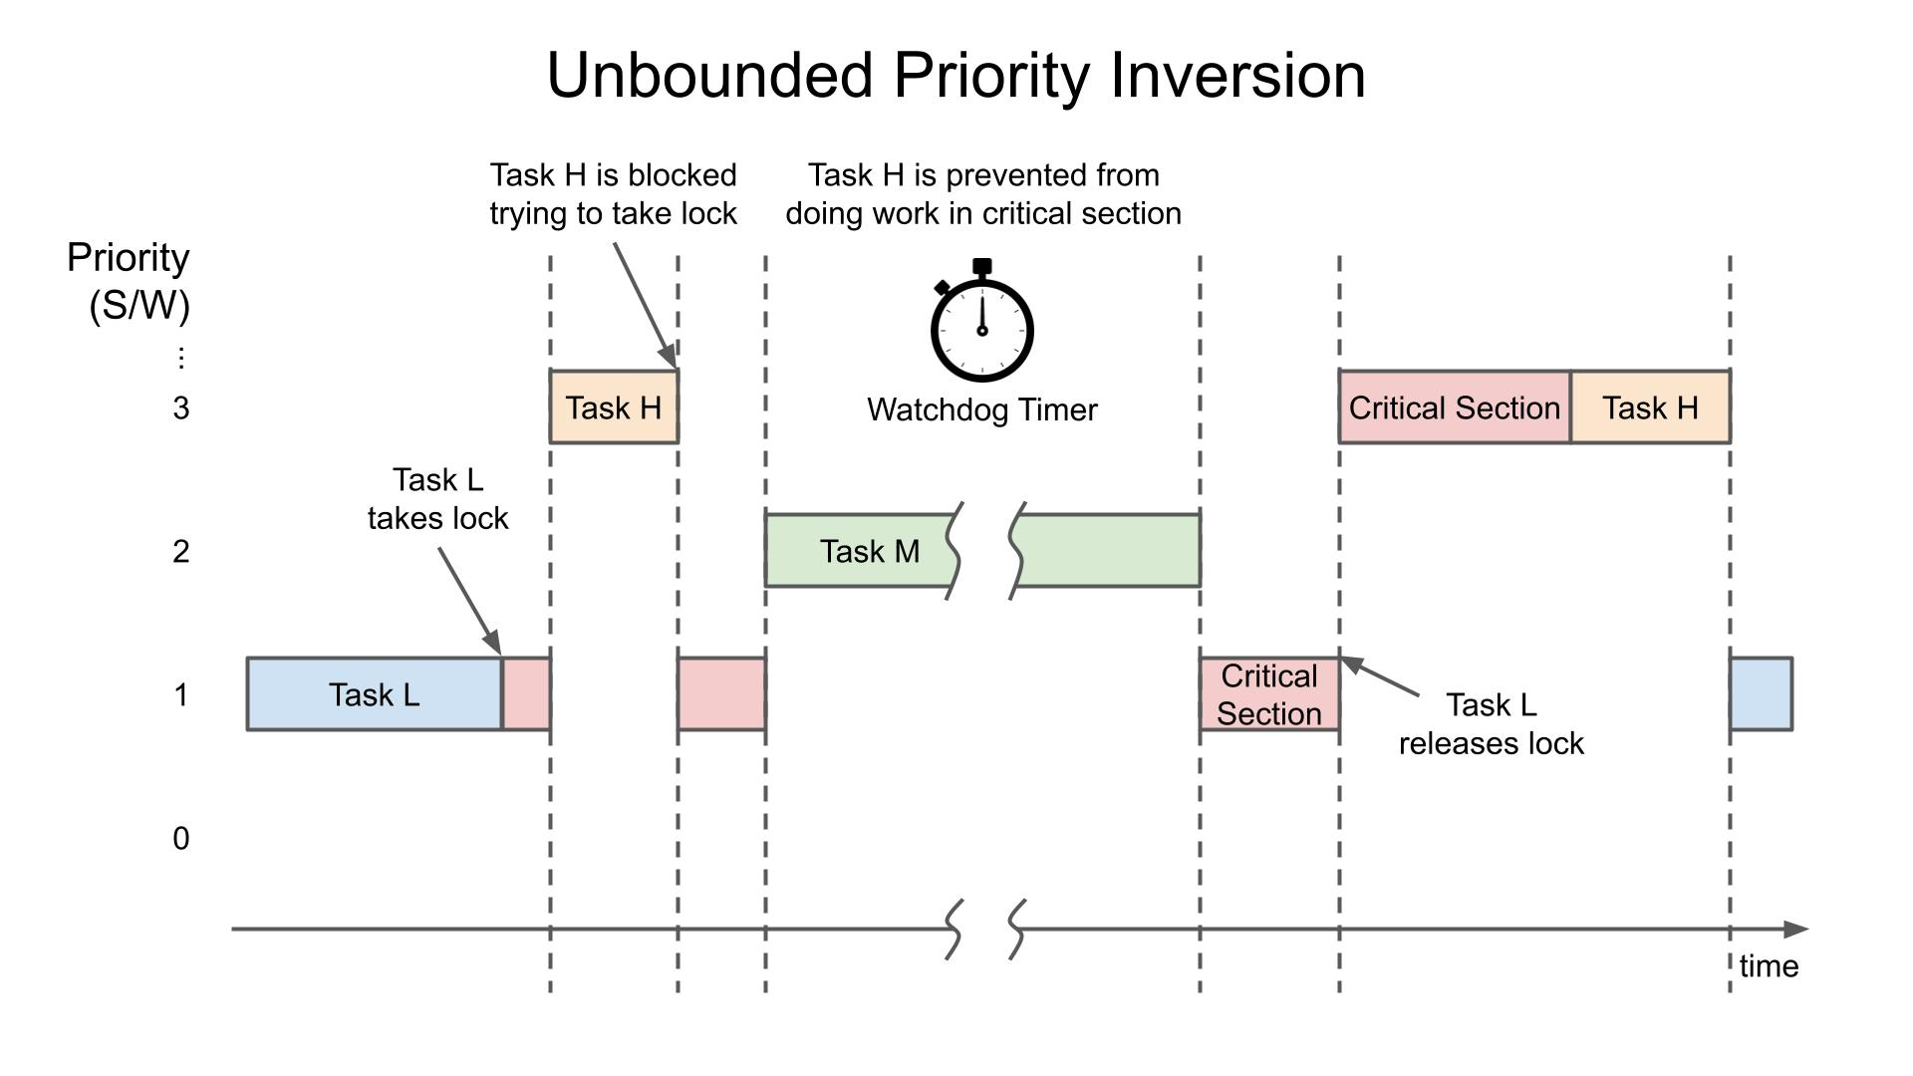
Point 2: Examples
Example 3: Priority inversion
Aim: develop an example with the priority inversion bug and then fix it
Three task with different priorities: High, Medium, Low
High task binary semaphore
Low semaphore binary semaphore but button to release it
Medium task linear execution

Slide 14
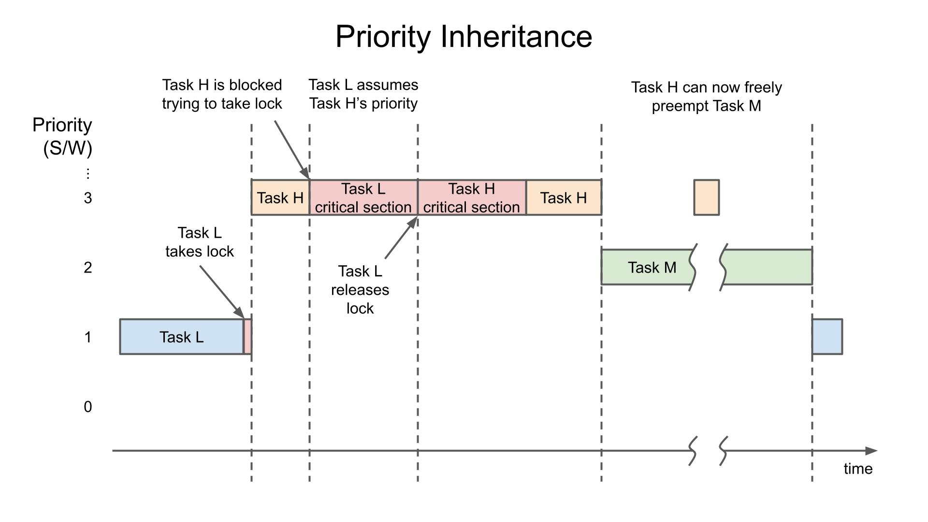
Point 2: Examples
Example 3: Priority inversion
mutexes in FreeRTOS implement priority inheritance
priority of low task temporarily raised

Slide 15
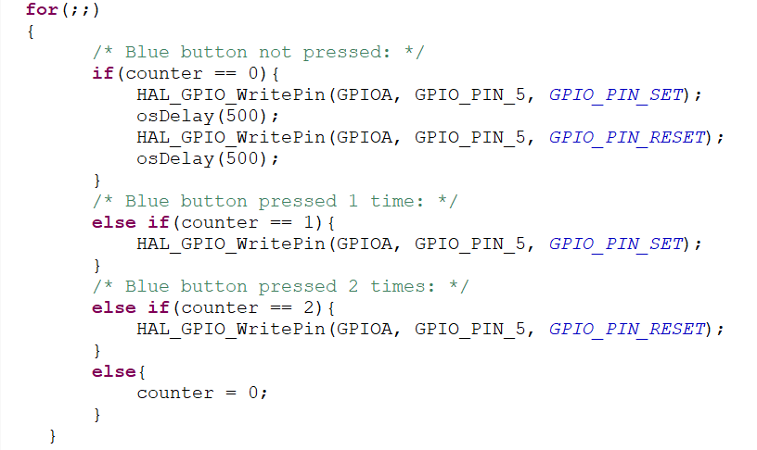
Point 2: Examples
Example 2: Led with interrupt
Aim: update the status of the green LED using the Blue Button
counter = 0, then it blinks with a period of 0.5 seconds;
counter = 1, then it remains lit;
counter = 2, then it remains off;
counter = 3, we start again the cycle by setting the counter =0

Slide 16
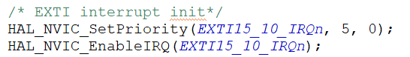
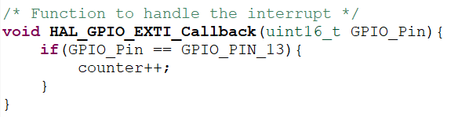
Point 2: Examples
Example 2: Led with interrupt
Callback function to update the counter when the interrupt occurs

Slide 17
Index
Point 3: Customization of the operating system
Point 1: Installation and usage procedures
Point 2: Examples illustrating the functionalities of the board
Point 3: Customization of the operating system
Point 4: Benchmarks of the results obtained in point 3

Slide 18
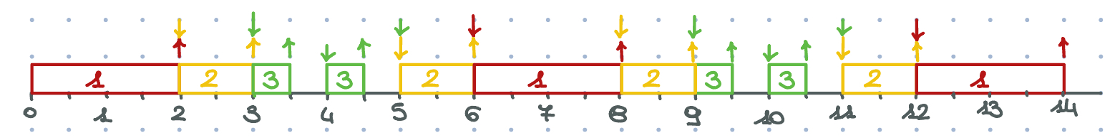
Point 3: Customization
Task 1 with priority = 3, an execution time of 2s and then stopped for 4s;
Task 2 with priority = 2, an execution time of 1s and then stopped for 2s;
Task 3 with priority = 1, an execution time of 0.5s and then stopped for 0.5s;
Customization of the operating system

Slide 19
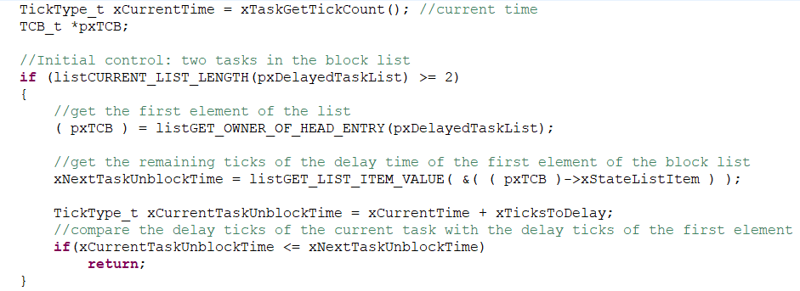
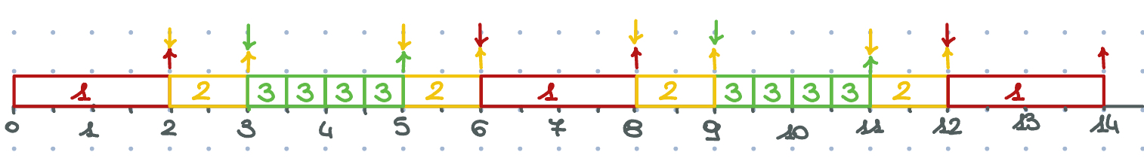
Point 3: Customization
Customization of the operating system

Slide 20
Index
Point 4: Benchmarks of the results obtained in point 3
Point 1: Installation and usage procedures
Point 2: Examples illustrating the functionalities of the board
Point 3: Customization of the operating system
Point 4: Benchmarks of the results obtained in point 3

Slide 21
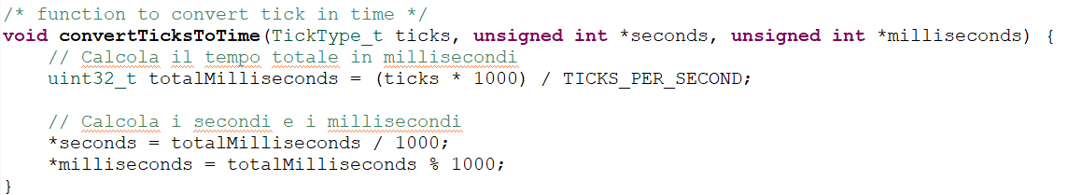
Point 4: Benchmarks
Benchmarks of the implementation
define the function convertTicksToTime()
timestamp for every task the tick of beginning and the tick of ending, convert them into seconds and milliseconds and then print them on the screen.

Slide 22
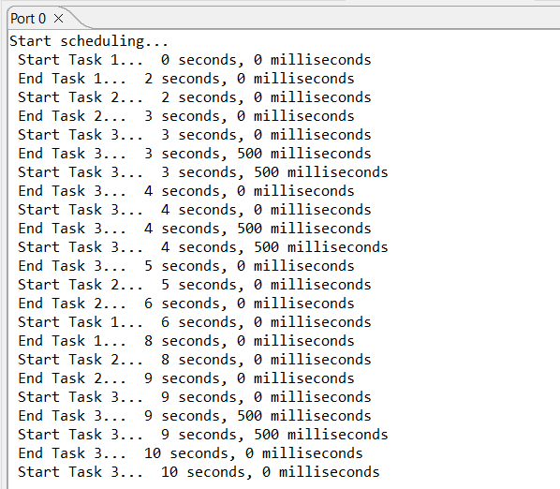
Point 4: Benchmarks
Final result:
Benchmarks of the implementation

Slide 23
Thanks for your attention!

